Slide 1

Mobile Usage Trends for Strategic Ad Targeting
SmartTarget Media
Elif Surucu | November 15, 2024

Slide 2

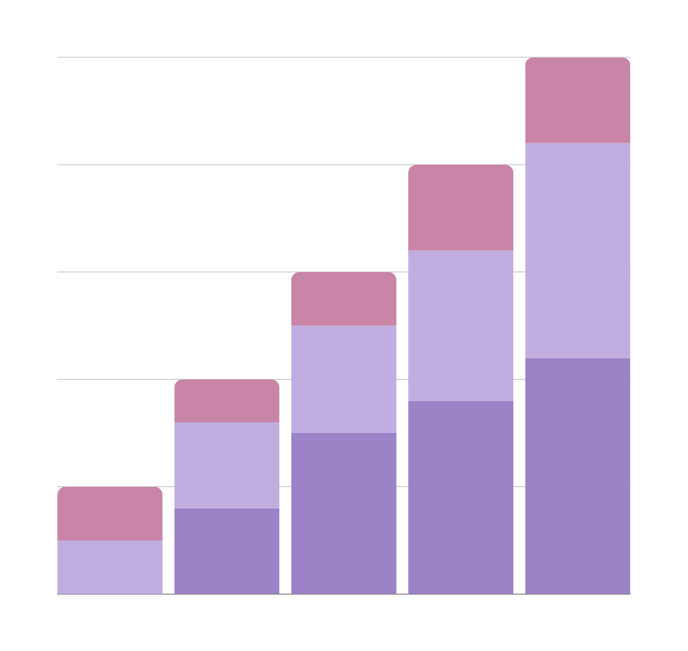
Analyzing mobile app usage trends to refine ad targeting, increase engagement, and maximize ROI.
Understand app usage patterns by demographic segments (age, gender, location).
Identify peak engagement times for each user type.
Develop data-driven insights for targeted ad placements.

Slide 3
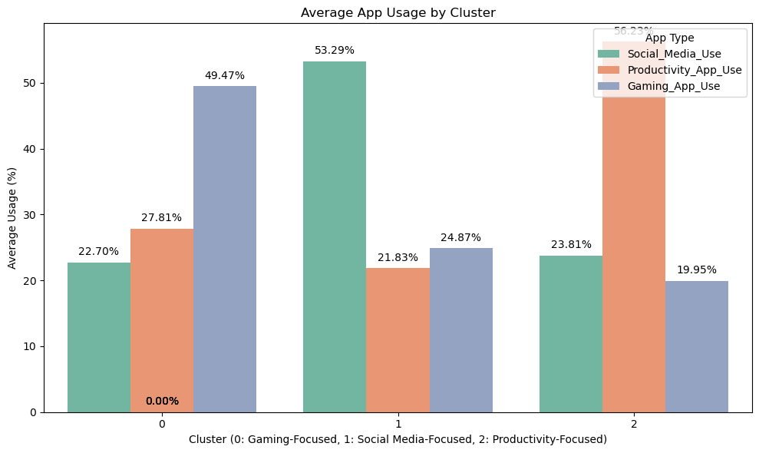
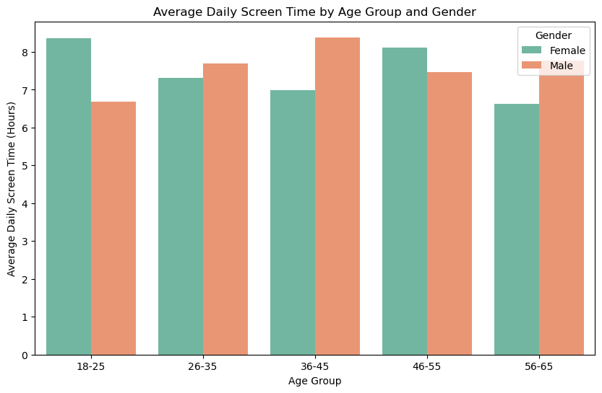

Key Mobile Usage Trends by Demographics
Demographic insights can drive segmented ad campaigns and improve relevance.

Slide 4
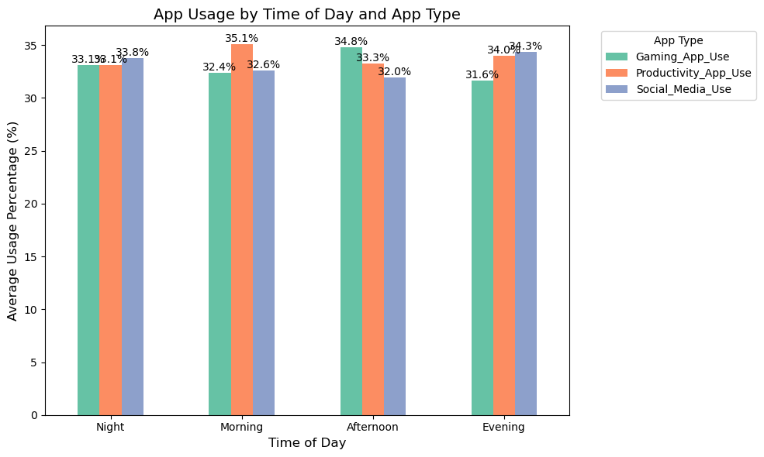

Statistical Insights for Targeted Strategies
According to the ANOVA test results, there is no statistically significant difference in the types of applications used at different times of the day.
These results suggest that users use all three types of apps at similar rates regardless of the time of day.
From a marketing strategy perspective, it appears that targeting certain types of apps at certain times of the day will not affect user habits.

Slide 5
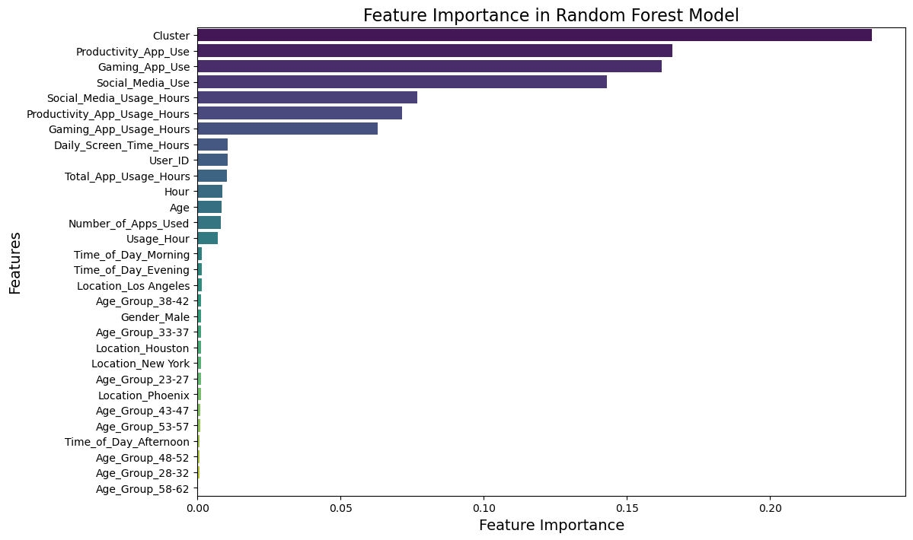
Predictive Modeling for Enhanced Targeting
Models Tested:
Random Forest: 95% accuracy.
XGBoost: 95% accuracy (Final Model).
The prominence of variables such as “Clustering” and “Productivity Application Usage” indicates that these features play an important role in user segmentation and target audience analysis.

Slide 6

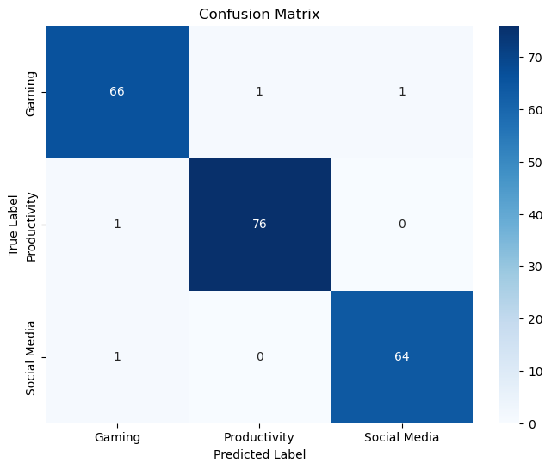
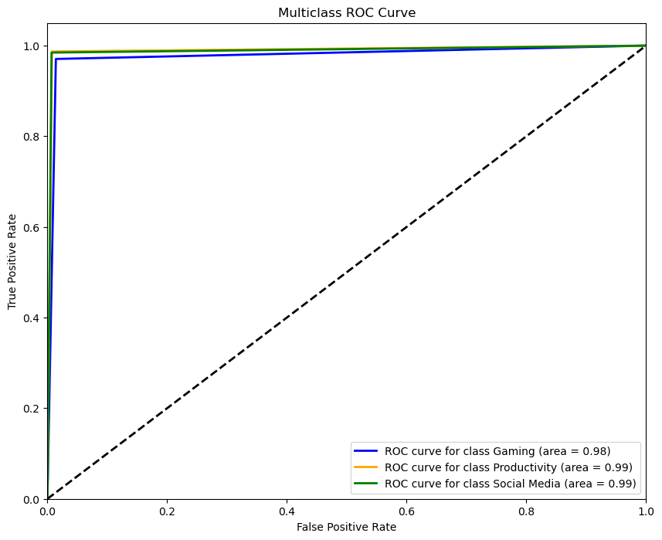
Model Accuracy and Strategic Application
High model accuracy enables refined segmentation, ensuring ads reach the right users at optimal times.
Social Media Ads:
Target specific age groups in the evening.
Gaming Ads:
Focus on late-night hours for engagement.
Productivity Ads: Prioritize work hours for targeting.

Slide 7
Thank you very much!

